Slide 1
Building and occupant characteristics as predictors of temperature-related illness in American households

Slide 2
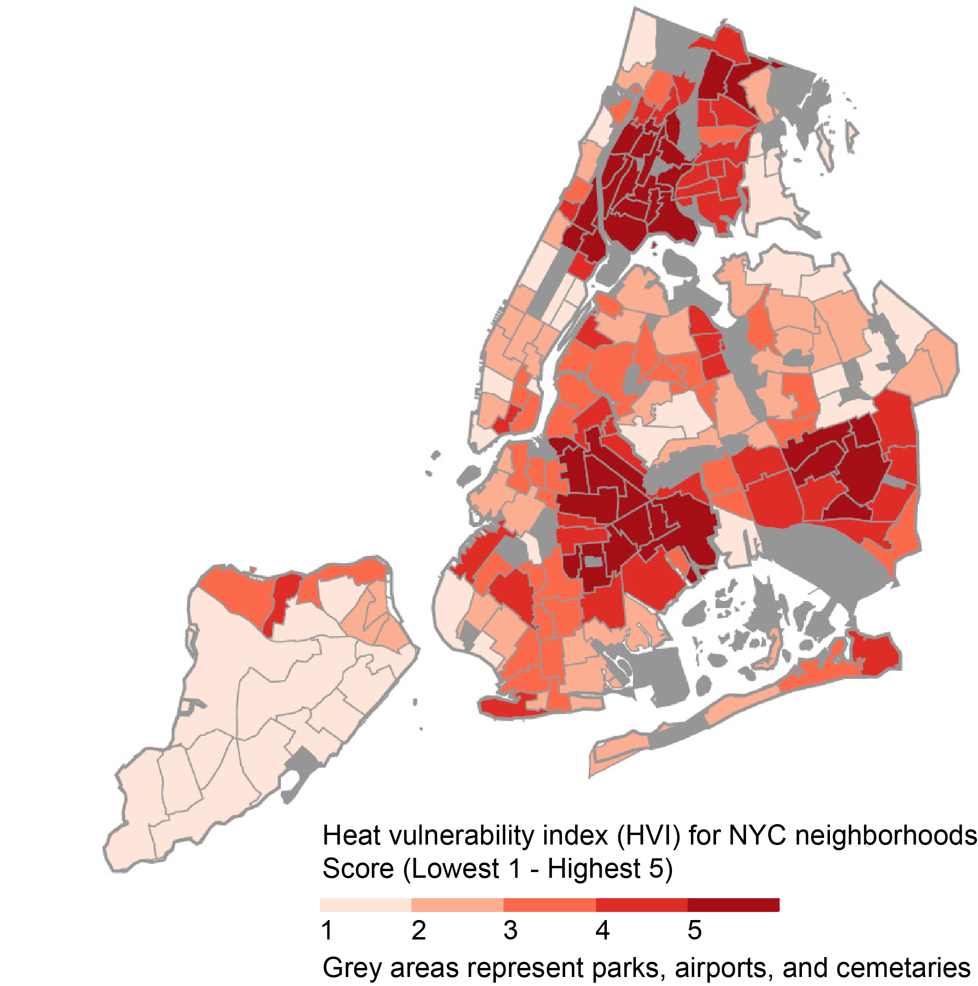
Would a HVI with detailed information about the building be more accurate at predicting the risk of health hazards? If so, by how much?
Which building and occupant characteristics contribute most to predicting the risk of a health hazards?
Image source: NYC Climate Resiliency Design Guidelines
Notes:
This is a map of the heat vulnerability index for New York City neighborhoods. The HVI score is a weighted sum of the prevalence of variables related to heat-related morbidity and mortality such as age, preexisting conditions, and income. The red areas highlight parts of the city with higher vulnerability. The city uses this map as part of short-term planning – locations of cooling centers, and long-term planning, design criteria for new city-owned buildings.
In this type of assessment by NYC and other places, the building characteristics of the local housing stock are rarely included. This study asks what building and other household characterize should public agencies prioritize for accurate assessment of thermal vulnerability.

Slide 3
Residential Energy Consumption Survey (RECS)
Source | U.S. Energy Information Administration (EIA)
Year | 2015 and 2020
Sample size | 5,700 and 18,500 households respectively
Sampling | Random, complex multi-stage area probability
Scope | U.S. households occupied as primary residence
Objective | Energy demand forecasting, energy efficiency planning
Notes:
I am using the Residential Energy Consumption Survey (RECS) from the U.S. Energy Information Administration.
This survey uniquely joins both building characteristics and household characteristic, which allows me to assess their relative importance.

Slide 4
Temperature-related illness
In the last year, did anyone in your household need medical attention because your home was too cold?
In the last year, did anyone in your household need medical attention because your home was too hot?
Used sample weights to estimate population prevalence as part of results
Combined 2015 and 2020 data sets in machine learning modeling
Table 1. Observations of temperature-related illness in RECS
 | 2015 | 2020 | Total
Heat-related | 39 | 76 | 115
Cold-related | 54 | 120 | 174
Any temperature | 81 | 171 | 252
None | 5,605 | 18,496 | 24,101
Notes:
The 2015 RECS asked two questions related to temperature-related morbidity. Due to limited samples, I’ll be focusing on comparing homes that experienced any temperature-related morbidity to those who did not.
From the onset we know we have an imbalanced data problem < 1% of the samples experienced any temperature-related morbidity. This is not an unusual problem in other domains like disease diagnosis and fault detection. We build in safeguards accounting for the class imbalance in the modeling process
Want Bill’s feedback on combining the data sets. Our reasoning was we could treat each sample as an observation of temperature-related illness or not. I corresponded with Carolyn previously, who shared that while

Slide 5






Predictive model
Climate
Demographic
Input variables
Output
Machine learning model
Temperature-related illness
Y/ N
Construction
Envelope
HVAC
Buildings
Notes:
Here is an overall framework for this project. I look forward to discussing the technical details during questions.

Slide 6
Input variables
Climate | Demographics | Buildings
 |  | Construction | Envelope | HVAC
Degree-days | Non-white | Construction age | Thermally massive wall | System type
 | Over 65 | Apartment | Thermally massive roof | Energy insecurity
 | Lives alone | Mobile home | Insulation | Fans
 | Large households |  | Infiltration | Off-grid
 | Poverty |  | Windows per room
 | Unemployed |  | Glazing type
 | Education level
 | Renting
 | Pays utility or fuel
Notes:
This represents the universe of input variables available to the machine learning model.
We are exploring modifications how we treat race and ethnicity by expanding to 4 categories: white, black, Asian, and Hispanic
We are also considering modifying energy insecurity to separately evaluate those struggling to operate (pay utility) vs maintain system (broken HVAC)

Slide 7
Machine learning model building
Binary classification model
Input: building and household characteristics
Output: temperature-related morbidity (Y/ N)
Model fitting
80/20 training/test data split
Training data subsampled to address class imbalance
Hyperparameter tuning with repeated 5-fold cross validation
Compare 8 machine learning algorithms
Generalized linear model, multivariate adaptive regression spline, penalized discriminant analysis, bagged classification and regression trees, random forest neural net.
Uncertainty
30 bootstrap iterations, with different training/test data splits
Notes:
Machine learning algorithms selected based on ability to accept class-weights and availability in caret R package
Spatial distribution of heat/cold-related illness

Slide 8
Machine learning model building contd.
Pre-processing
Checked for zero or near-zero variance, which removed two demographic variables
Large households and pays utility/fuel
Checked for correlated variables and linear combinations, but none removed
Normalize numerical inputs to have zero mean and unit variance
Imbalanced class handling:
Class-weights – higher penalty for misclassifying homes with temperature-related illness
Up-sampling – over sample minority class
SMOTE and ROSE – generate synthetic data in minority class and under sample majority class
Performance metrics suited for imbalanced data: balanced accuracy, recall, precision.

Slide 9
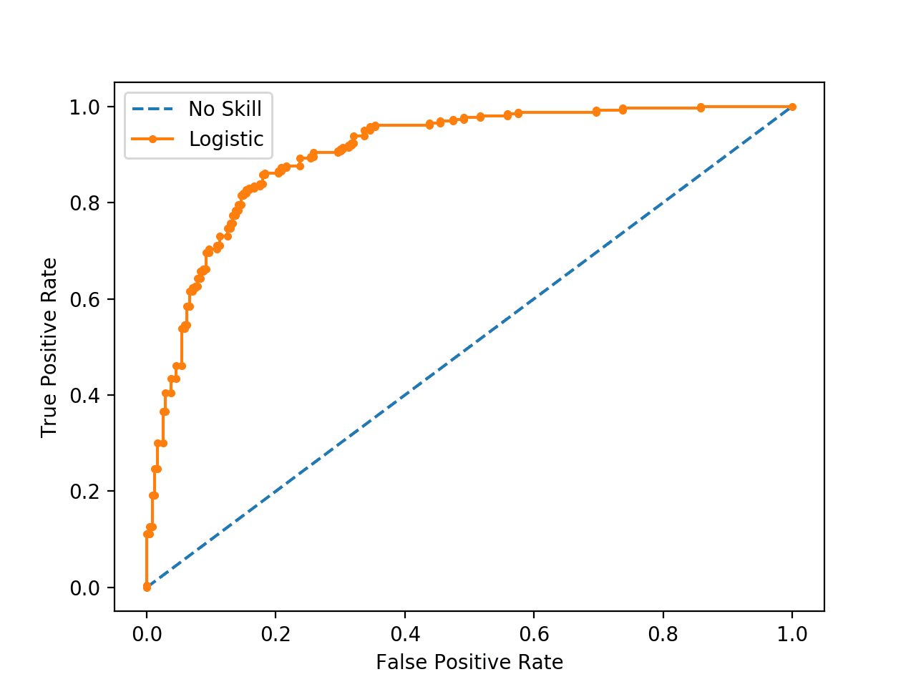
Machine learning model performance
 |  | Predicted
 |  | Yes | No
Actual | Yes | True positive | False negative
 | No | False positive | True negative
For binary classification, Receiver Operator Characteristic (ROC) is the typical choice
Based on the confusion matrix
Sensitivity (true positive rate): TP/TP+FN
Specificity (true negative rate or 1-false positive rate): TN/TN+FP
ROC curve plots the sensitivity and specificity for different thresholds
Area under the ROC gives a single metric to capture the entire curve
This metric is ill-suited for imbalanced data sets because the number of TN is so much larger

Slide 10
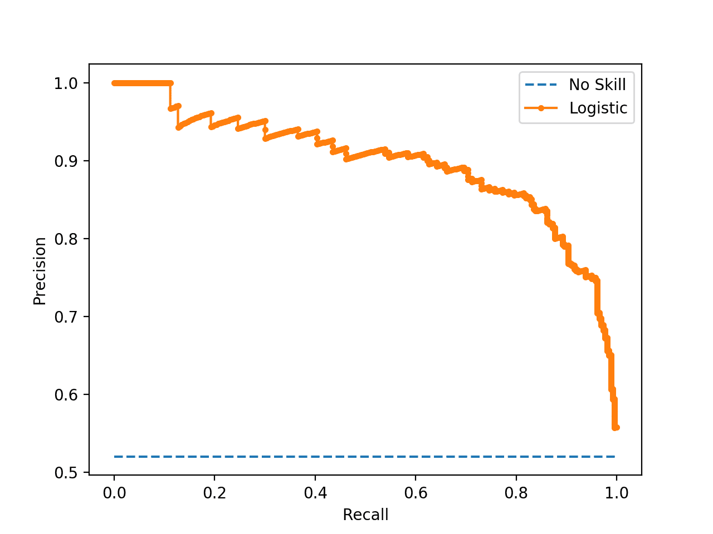
Machine learning model performance contd.
Based on the confusion matrix:
Precision: TP/TP+FP
Recall: TP/TP+FN (same as sensitivity)
The PR curve plots these values at different thresholds
The area under the PR curve summarizes the curve into one metric
Because neither precision or recall use the number of TN, this metric is well suited for imbalanced data
 |  | Predicted
 |  | Yes | No
Actual | Yes | True positive | False negative
 | No | False positive | True negative

Slide 11
Machine learning model performance contd.
Selected hyperparameters based on area under PR curve
In the test set evaluated:
Balanced accuracy (average of sensitivity and specificity)
Recall
Precision
For best regression model, looked at variable coefficients to comment on variable importance
Also evaluated tradeoff between model accuracy and computation time
Notes:
Balanced accuracy is an alternative to overall accuracy for imbalanced data sets because it averages the model’s accuracy for each class. A naïve model will have a sensitivity of 0, a specificity of 1, so a balanced accuracy of 50%. If we used accuracy, a naïve model would have an accuracy equal to the proportion of the majority class, in this class 99%.

Slide 12
Summarize class imbalance handling
Stratified sampling at each split of the data set based on the occurrence of temperature-related illness
Fewer k-folds to retain more minority class samples for cross-validation (10 is typical, we used 5)
Considered class-weights
Considered sub-sampling
Selected performance metrics appropriate for imbalanced data
Notes:
Ensures that we will not have a cross-validation fold without any observations of temperature-related illness
D
And 4) are referred to class imbalance handling scheme

Slide 13
Comparison of input features groups
Train one set of models with Climate + Demographics variables and another with Climate + Demographics + Buildings variables
Compared results with paired t-test (based on bootstrapped iteration)
Consider p < 0.05 statistically significant
For statistically significant results, calculate Cohen’s d for effect size
0.4 < |d| < 1.15 for recommended minimum practical effect
1.15 < |d| < 2.7 for moderate effect
|d| > 2.7 for strong effect

Slide 14
Results

Slide 15
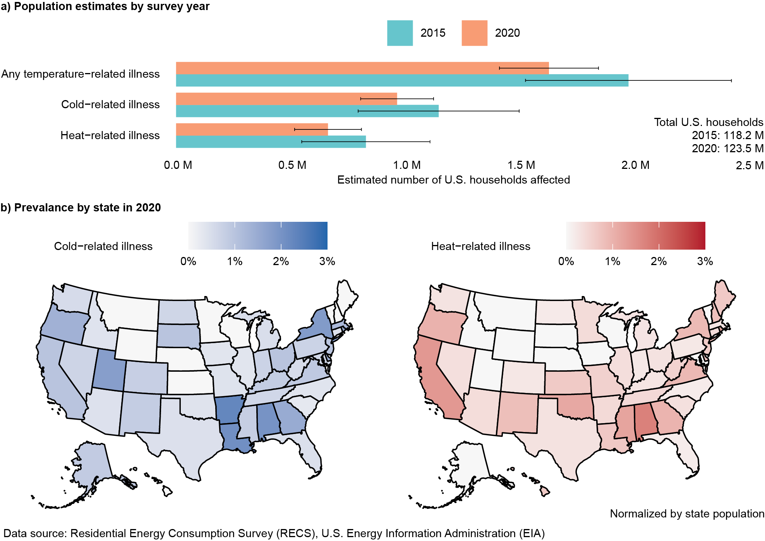
Figure 1: Prevalence of temperature-related illness in U.S. households
Notes:
The EIA provides R script for population estimates and standard error for each year’s data set
Around 2 million households impacted by temperature-related illness annually
2020 sample size was 3x larger, so the error bars are smaller than 2015
What if we resampled the entire data set first according to the weights
Estimate state level population estimates for 2020 data sets

Slide 16
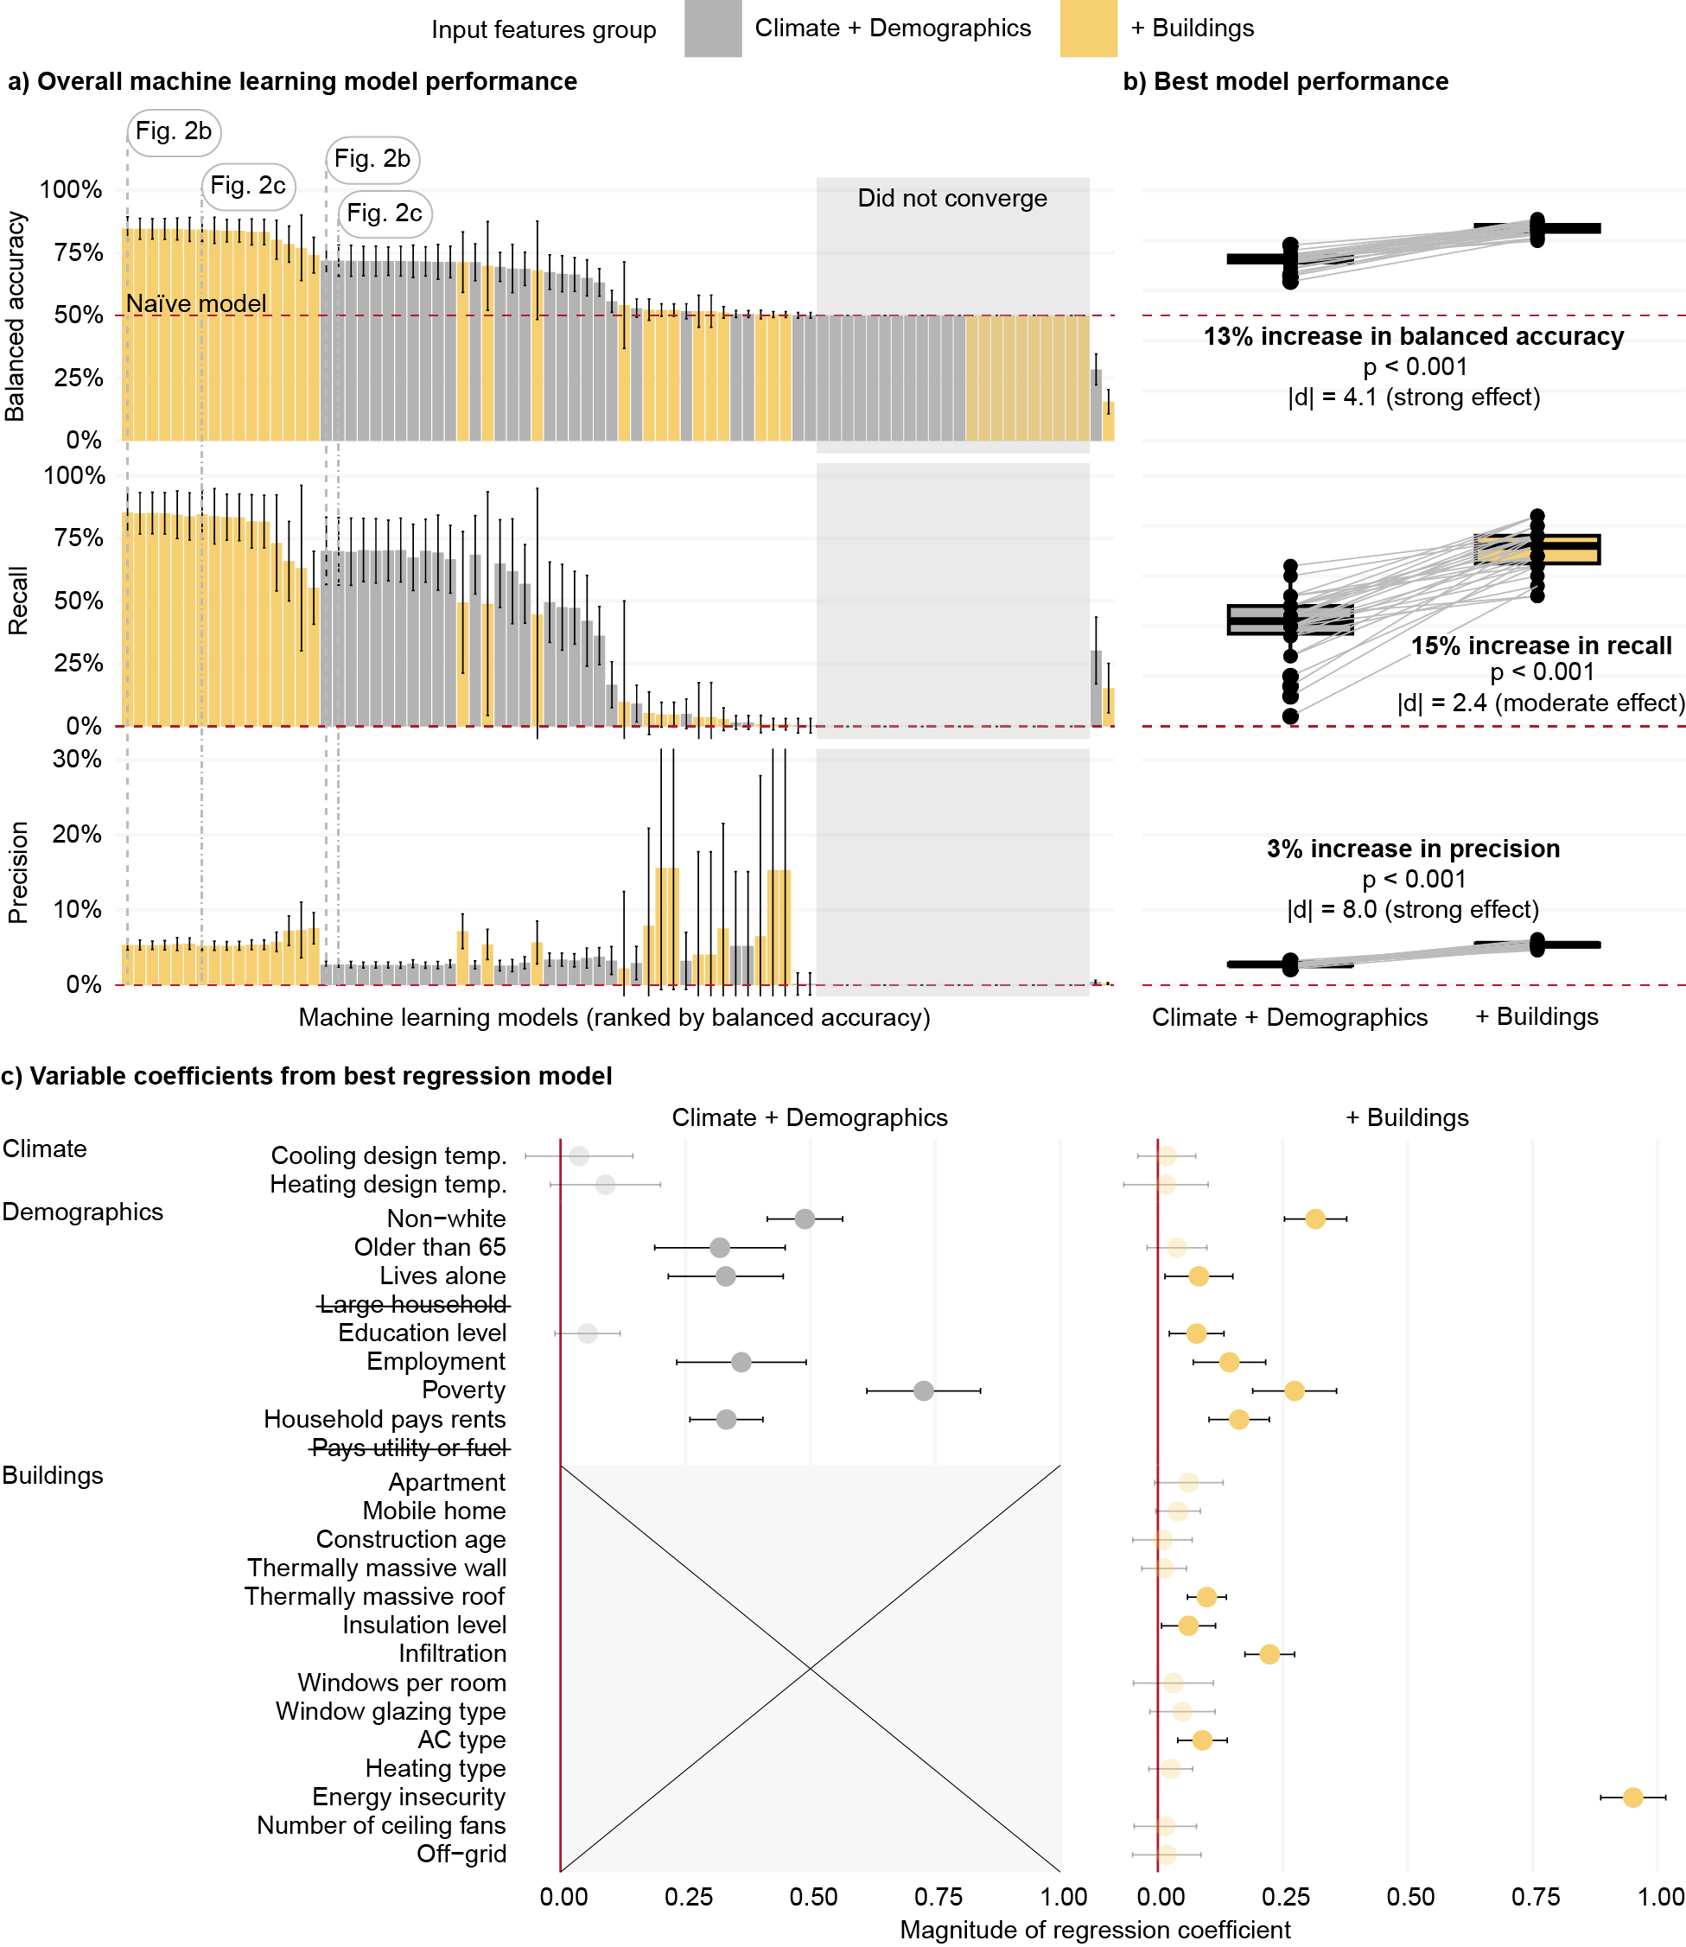
Figure 2: Predicting temperature-related illness

Slide 17
Figure 2a and 2b: Machine learning model performance
Notes:
Starting with a) each bar represents machine learning models with the same input features group, class imbalance handling scheme, and machine learning algorithm. The error bars represent 95% confidence intervals, calculated from the 30 bootstrap samples
We see that models that include buildings variables perform better. Figure 2b pulls out the top performing model from each input features group, and we find 13% increase in balanced accuracy, 15% increase in recall, and 3% increase in precision
We also do have a lot of models with poor performance (similar to the naïve model) and many of these did not converge
Figure 2c pulls out the best regression model to evaluate variable coefficients. Its performance is within the 95% confidence interval of the best model of each input features group

Slide 18
Figure 2c: Variable coefficients from top regression model
Notes:
Energy insecurity by far has the highest coefficient magnitude almost
The demographics only model compensates by giving more weight to other variables, namely poverty, non-white, employment, renting, older than 65, and lives alone. Many of these variables also show up in the buildings model.
Non-negligible coefficients for insulation label, infiltration, thermally massive roof, and ac type.

Slide 19
Discussion
Study demonstrates that we can predict temperature-related illness to relatively high accuracy (up to 85%) but precision is low (around 5%)
Therefore, we predict many false positives, but that could be due to temperature-related illness being underreported
Energy insecurity is by-far the most important predictor of temperature-related illness, in line with heat death investigations in Maricopa County, Arizona
This gives public health authorities a pathway to
Prioritize data collection to identify at-risk households more accurately
Design more effective interventions to prevent temperature-related illness (e.g. British Columbia launched a $10 million program last summer to distribute window AC units to vulnerable households)

Slide 20
Limitations
RECS only represents homes occupied as primary residence and most notably does not include nursing homes
RECS is self-reported by household resident

Slide 21
Specific questions
How are climate variables such as design temperature calculated?
Have there been any studies validating the self-reported approach?
What is the background behind the questions regarding heat or cold-related illness?
Are there any noteworthy studies utilizing RECS data you recommend?

Slide 22
Thank you for your time!

